Slide 1

Digital Divide
Presented By
Akshat, Kunal, Siddik, Mohit, Nikhil

Slide 2

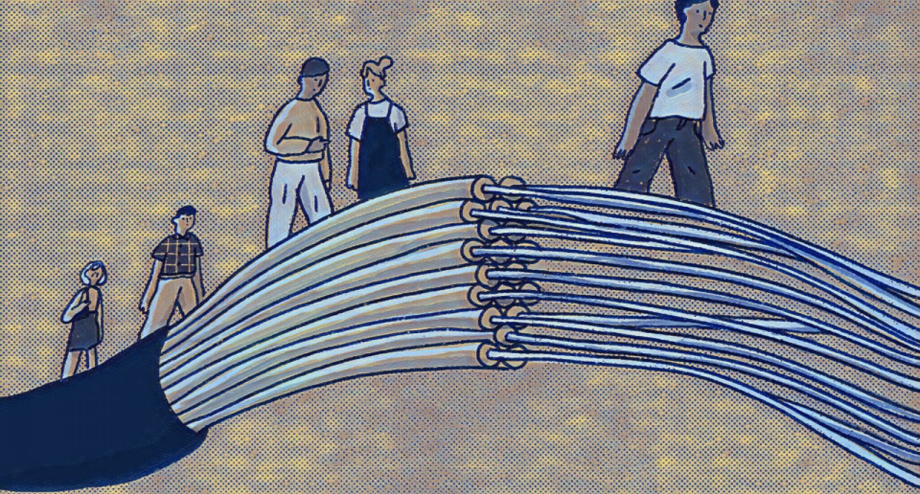
What is the Digital Divide?
The digital divide refers to the gap between individuals and communities that have access to digital technologies and those who do not. This presentation explores the implications of this divide on society.
This Photo by Unknown author is licensed under CC BY-NC.

Slide 3

Causes of the Digital Divide
Factors contributing to the digital divide include:
income disparities
Gender disparities
geographic location
educational factors
technological infrastructure.
Age and Generational Divide
Government policies and regulations
Cultural and Language barriers

Slide 4
Consequences for Society
The digital divide can lead to disparities in education, healthcare, economic opportunities, and civic engagement, impacting various aspects of society.

Slide 5

The Global Perspective
The digital divide is not limited to a single country. It is a global issue, with developing countries facing more significant challenges in bridging the gap.

Slide 6

Measuring the Digital Divide
Researchers use various indicators such as internet penetration rates, access to devices, and digital skills to measure the extent of the digital divide.

Slide 7

Bridging the Digital Divide
Bridging the digital divide is a crucial goal for promoting equitable access to digital technologies and the benefits they offers.
Investing in Infrastructure
Affordability Initiatives
Public Access Points

Slide 8
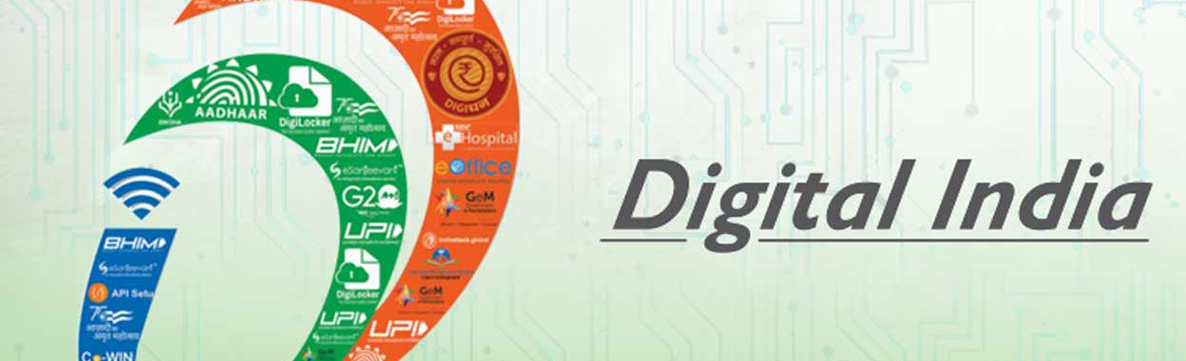
Digital Inclusion Efforts
Governments can play a vital role in digital inclusion through policies and programs that promote affordable access, digital literacy, and equitable distribution of resources.
Non-governmental organizations and tech companies are actively involved in digital inclusion efforts, providing resources and support to underprivileged communities.

Slide 9
Implications on Education
The digital divide impacts education, creating disparities in access to online learning resources, which has been particularly evident during the COVID-19 pandemic.
Inequitable Access to Learning
Achievement Gaps
Teacher-Student Interaction

Slide 10

Mizoram Students Trek For Hours Through Dense Forest To Take Online Exams
https://thelogicalindian.com/responsiblebusiness/breaking-barriers-inspiring-stories-of-women-entrepreneurs-41263?infinitescroll=1

Slide 11

The Healthcare Divide
Unequal access to telemedicine and digital health resources exacerbates health inequalities, limiting healthcare access for some populations.
Notes:
the healthcare digital divide, is a term that describes the disparities in access to and utilization of digital technologies and information in the context of healthcare. It signifies the unequal distribution of digital resources and tools that are increasingly essential for managing and accessing healthcare services and information. This divide can manifest in various ways and can affect individuals and communities differently.

Slide 12
Economic Consequences
The digital divide affects job opportunities and income inequality, as many jobs increasingly require digital skills.
Notes:
The digital divide often exacerbates income inequality. People who lack access to digital technologies may miss out on economic opportunities, such as remote work, online learning, and e-commerce. This can lead to a wider income gap between those with digital access and those without.
In the digital age , Limited Employment Opportunities is also the problem, many job opportunities require digital skills. Those who lack access to the internet and digital devices may find it challenging to access job listings, apply for positions, and develop the skills needed for modern workplaces.

Slide 13

Social and Civic Engagement
Limited access to the internet can hinder participation in civic activities and social interactions, affecting community cohesion.
Notes:
Social and civic engagement are important concepts related to the active participation of individuals in society and their involvement in the political and civic processes that shape the community and the nation.
In the digital age, social media platforms have become essential for maintaining social connections. Those with access to the internet can more easily engage with friends, family, and peers, strengthening social bonds and community ties.

Slide 14

Future Prospects
As technology evolves, addressing the digital divide will continue to be a critical social and policy challenge.
Notes:
Future prospects may include a focus on government policies and regulations aimed at reducing the digital divide. Net neutrality, digital inclusion initiatives, and privacy laws can significantly impact the accessibility of technology.
The digital divide has prompted innovative solutions, such as low-cost smartphones, community Wi-Fi initiatives, and digital literacy programs. These innovations are likely to continue and evolve in the future.

Slide 15

Privacy and Security
The digital divide can expose vulnerable populations to privacy and security risks, especially when they lack access to secure technologies.
Notes:
Lack of digital literacy in some populations can result in a lack of understanding about online privacy risks and the importance of safeguarding personal data.
Enact and enforce laws and regulations that protect individuals' privacy and personal data online, irrespective of their digital access and literacy.

Slide 16

How Digital Divide impacts Democracy?
In a democracy, access to information is crucial for informed decision-making. Those without reliable internet access may be less informed about current events, candidates, and policy issues, potentially impacting their ability to make informed voting choices.
When certain segments of the population lack access to the internet or digital devices, they may miss out on important policy information, public consultations, and opportunities to voice their opinions. This can lead to unequal representation in the policy-making process.

Slide 17
COVID-19 Pandemic
The digital divide became particularly apparent in the realm of education, as many students lacked the means to participate in remote learning effectively.
Efforts to bridge this divide have become more critical than ever, as society increasingly relies on digital tools and platforms for work, healthcare, and social interaction.
The COVID-19 pandemic acted as a catalyst for digital evolution by accelerating the adoption of existing technologies and driving innovation. This led to significant investments in digital infrastructure.

Slide 18

Situation in Jammu and Kashmir
On August 5, 2019, internet and voice calling were snapped in Jammu and Kashmir, following the abrogation of Article 370 and these are yet to be fully restored.
The situation in Jammu and Kashmir is deplorable and pathetic, particularly for its students, who have been suffering for the last 30 years, in one way or the other.
The abrupt and frequent snapping of 2G (which is not enough to run the video lecture smoothly anyway), in the midst of online lectures, makes the situation very difficult for students and teachers.
It must be added that the speed of the internet here has not risen from 2G to 4G since last year.

Slide 19
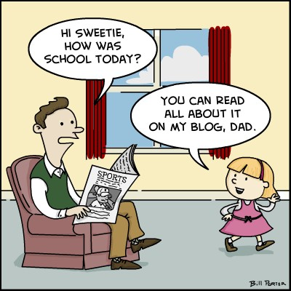
Generational Gap
Disparities in access to and use of digital technologies between different age groups, particularly older and younger generations.
Digital natives, those who have grown up using technology, often have higher levels of digital literacy. They are more comfortable using digital tools

Slide 20
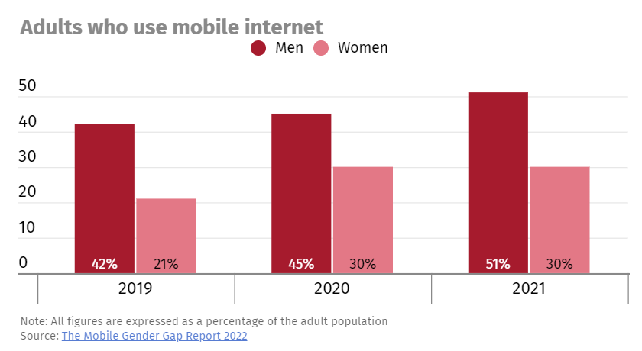
Gender Digital Divide
Disparities in internet access, digital literacy, and technology usage between men and women.
Traditional gender stereotypes in India can discourage women from using digital technologies.
Concerns related to online safety and privacy may also deter women from using the internet and social media platforms.

Slide 21
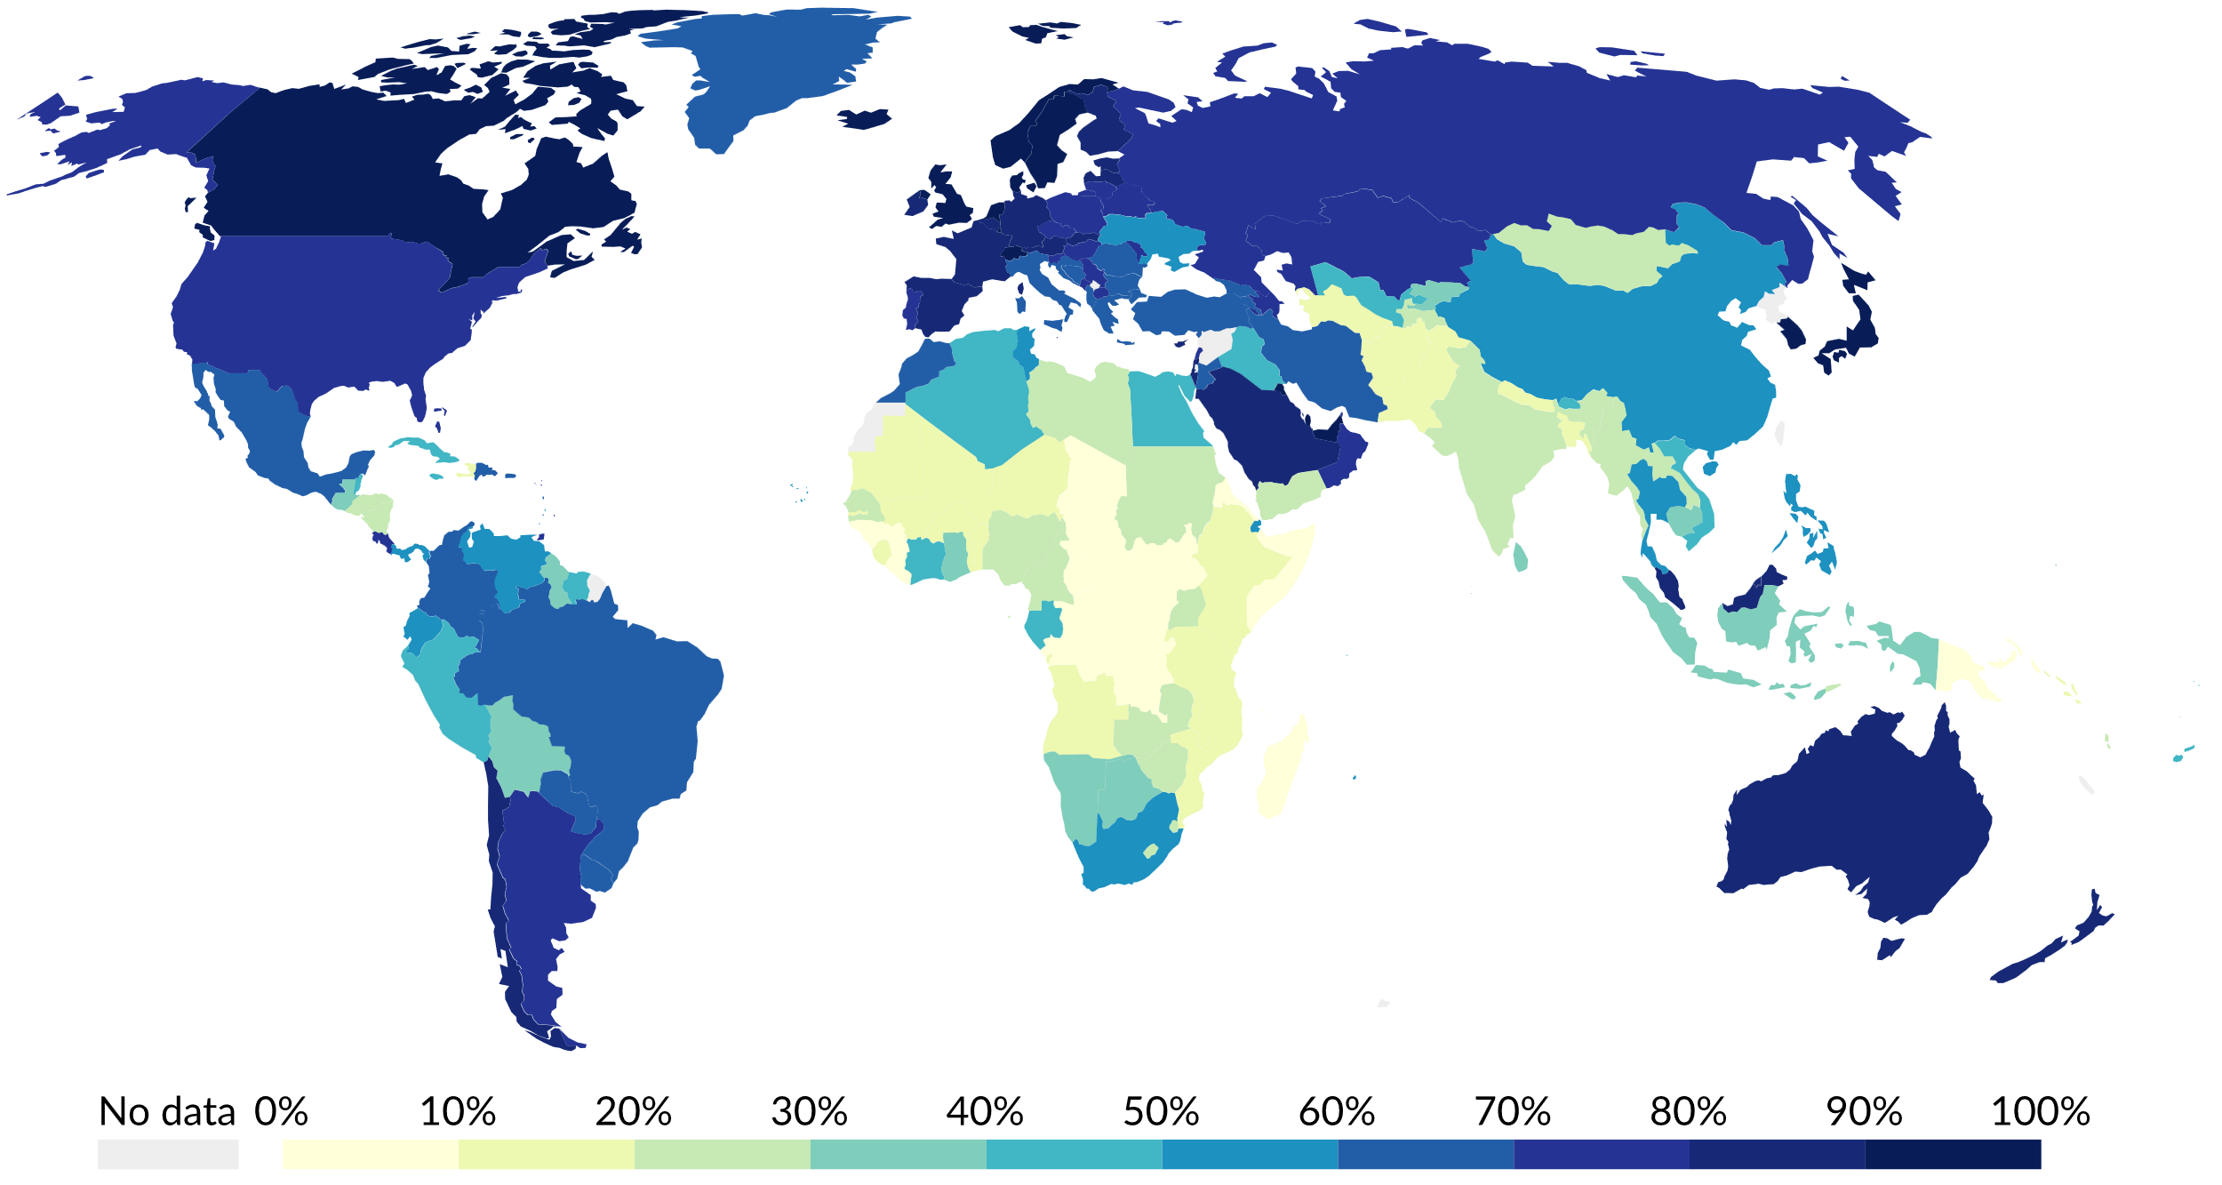
Global Digital Divide
Percentage of individuals using the Internet

Slide 22
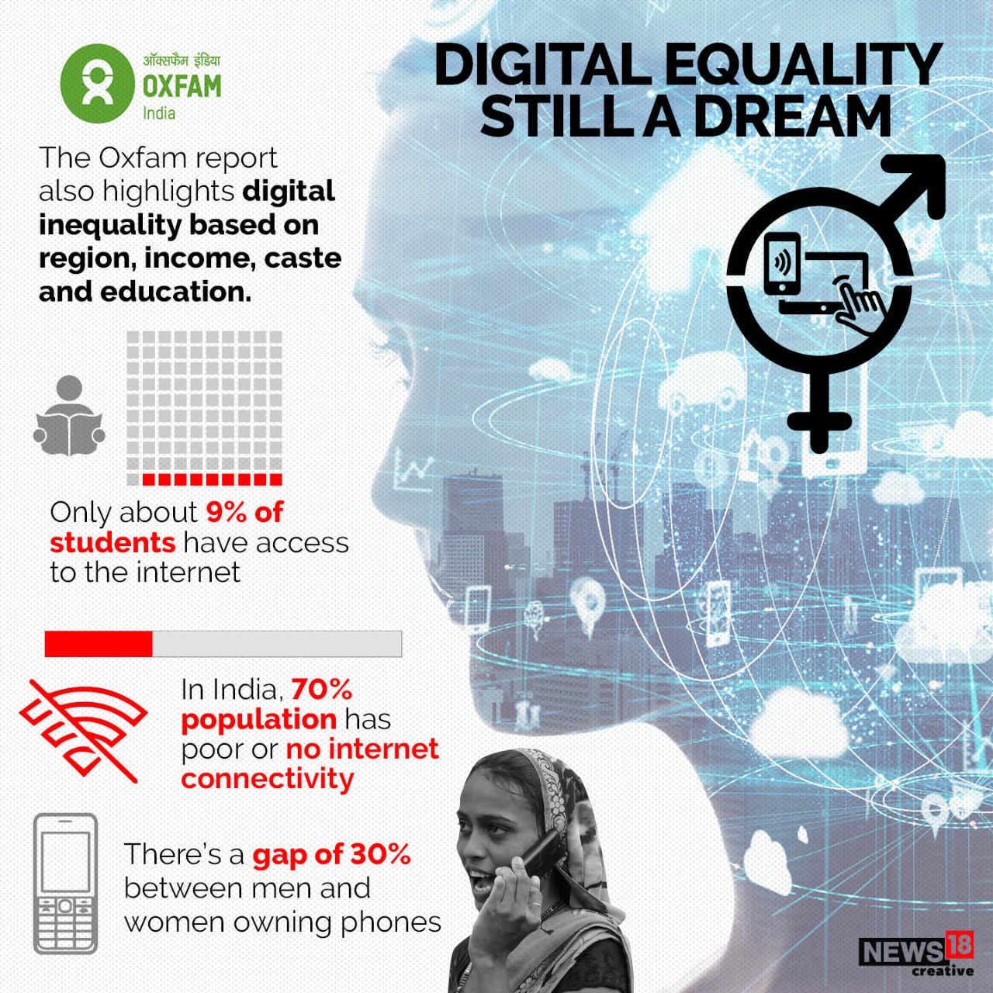
Oxfam Report
Within the Asia-Pacific region, India’s gendered digital divide fares the worst with a wide gap of 40.4 per cent between internet usage among men and women, the report states.
The report cites a February 2022 story from Business Today that states that 25,067 villages in India do not have mobile and internet connectivity.

Slide 23
Community Initiatives
Digital literacy programs to help those who may not be familiar with technology, gain essential digital skills. Provide training in using computers, and various software applications.
Community initiatives often partner with local schools, libraries, churches, and nonprofit organizations to leverage existing resources and infrastructure.
Community initiatives may involve the distribution of low-cost or donated devices to ensure that residents have the means to connect to the digital world.

Slide 24
The Role of Government
Policies that promote affordable broadband access. Regulatory bodies often oversee the telecommunications industry to ensure that providers extend their services to rural and underserved areas.
Educational institutions, often funded or regulated by the government, can play a crucial role in bridging the digital divide. Governments may ensure that schools provide access to digital devices and incorporate digital literacy into the curriculum.
Governments can lead by example in providing online services and information. This not only improves government efficiency but also encourages citizens to get online and use digital tools.

Slide 25

Unified Payments Interface (UPI)
Example of government-lead digital initiatives that how governments can play a role in promoting digital inclusion.
It has transformed the way individuals and businesses handle financial transactions, making it accessible to people even in remote areas with limited access.

Slide 26

Global Collaboration
Awareness and Advocacy: Various international organizations, non-profits, and advocacy groups work to raise awareness about the digital divide. They highlight the importance of addressing this issue and the societal and economic consequences of a wide digital gap. They also advocate for policies and initiatives to bridge the divide.
Policy Development: Governments around the world collaborate on creating policies and regulations that aim to reduce the digital divide. This can involve providing subsidies for broadband access, funding digital literacy programs, and ensuring that internet infrastructure reaches underserved areas.
Financial Assistance: Developed nations often provide financial aid and support to developing countries to help them improve their digital infrastructure. This assistance can include funding for building internet infrastructure, providing training and resources, and offering grants to expand digital access.

Slide 27
Future Challenges
Broadband Access: Ensuring equitable access to high-speed broadband remains a challenge, particularly in rural and remote areas. As digital services and content become more data-intensive, the need for robust internet connections is increasing.
5G and Beyond: The rollout of 5G and subsequent generations of wireless technology will create new disparities. Access to high-speed mobile networks and the devices that support them will be essential for accessing advanced services, but not everyone will have equal access.
Affordability: While infrastructure improvements are vital, the cost of internet access and digital devices can be prohibitive for many. Bridging the affordability gap is crucial, especially for low-income households.

Slide 28

The Role of Schools
Access to Technology: Schools can provide students with access to digital devices such as computers, tablets, and internet connectivity. This is particularly important for students who may not have access to these resources at home.
Digital Literacy: Schools can teach digital literacy skills to students, ensuring they know how to use technology effectively and safely. This helps bridge the knowledge gap between those who are tech-savvy and those who are not.
Equal Educational Opportunities: By providing digital resources and tools, schools can help level the playing field for all students, regardless of their socioeconomic background. This can reduce disparities in educational outcomes.

Slide 29
Future Workforce
Skills Gap: The digital divide can result in a significant skills gap, where individuals with limited access to technology and digital resources may lack the skills needed for many jobs. As more industries require digital literacy, the divide can hinder employability.
Employment Opportunities: Access to the internet and digital tools has become essential for job hunting and applying for positions. People with limited access may miss out on opportunities and face challenges in finding employment.
Remote Work: The COVID-19 pandemic highlighted the importance of remote work. The digital divide can limit the ability of some individuals to work from home effectively, potentially affecting their job options and career mobility.

Slide 30
Ongoing Research
Access Disparities: Researchers are investigating the disparities in access to digital technologies, including broadband internet, digital devices, and the availability of digital infrastructure. They are examining how these disparities vary by geographic location, income level, age, and other demographic factors.
Socioeconomic Impacts: Studies continue to explore the socioeconomic impacts of the digital divide. Researchers are examining how limited access to digital resources affects income, education, employment opportunities, and overall quality of life for underserved populations.
Educational Inequities: Ongoing research investigates how the digital divide affects educational outcomes. This includes studies on the impact of limited access to online learning resources, the homework gap, and the effectiveness of interventions aimed at bridging these educational gaps.

Slide 31

CONCLUSION

